Slide 1




NarrateIT- Interactive Storytelling
Group 1
Sarala Sharanappa Kanakagiri
Rushitaben Pravinbhai Vachhani
Amisha Bhawsar

Slide 2






Overview
An immersive Java-based application that lets users explore deep, branching narratives through an interactive storytelling experience. The app uses external CSV files to load richly detailed stories, allowing for easy updates and expansion of the narrative content.

Slide 3


KEY FEATURES
Branching Decisions
Navigate through dynamic stories by making meaningful choices at every chapter, shaping your unique storyline.
Character Customization
Personalize your character’s details (name, gender, role, traits) that dynamically influence narrative perspectives.
CSV-Based Content Management
Effortlessly update, expand, or manage narrative content through externally stored CSV files.
Save, Load & History Tracking
This concise layout clearly highlights your app's strengths and makes them easily understandable in a presentation.

Slide 4



Tech Stacks
This application leverages Java 17 with Swing to deliver a visually modern, interactive storytelling experience. Key tools like OpenCSV, Maven, and GitHub streamline data management, build automation, and version control.
Language: Java 17
UI Framework:
Java Swing
CSV Parsing: OpenCSV
Build Tool: Maven
Version Control:
Git & GitHub

Slide 5
Object-Oriented Concepts
Encapsulation – All classes maintain data privacy using private attributes and public accessors/mutators.
Inheritance – Can be extended further for different types of stories or characters.
Polymorphism – UI components and actions respond differently based on the state (e.g., character role affecting narrative).
Abstraction – Clear separation between UI handling, logic, and data models

Slide 6

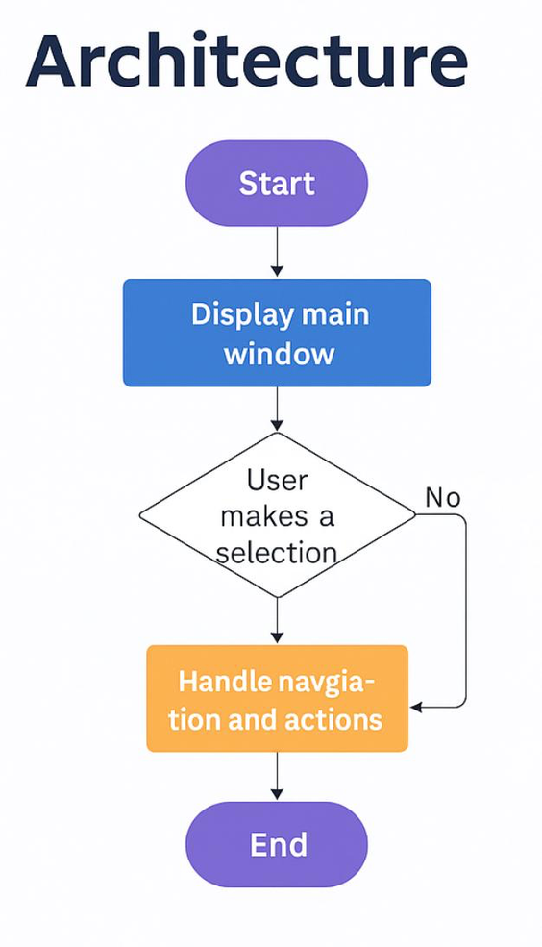
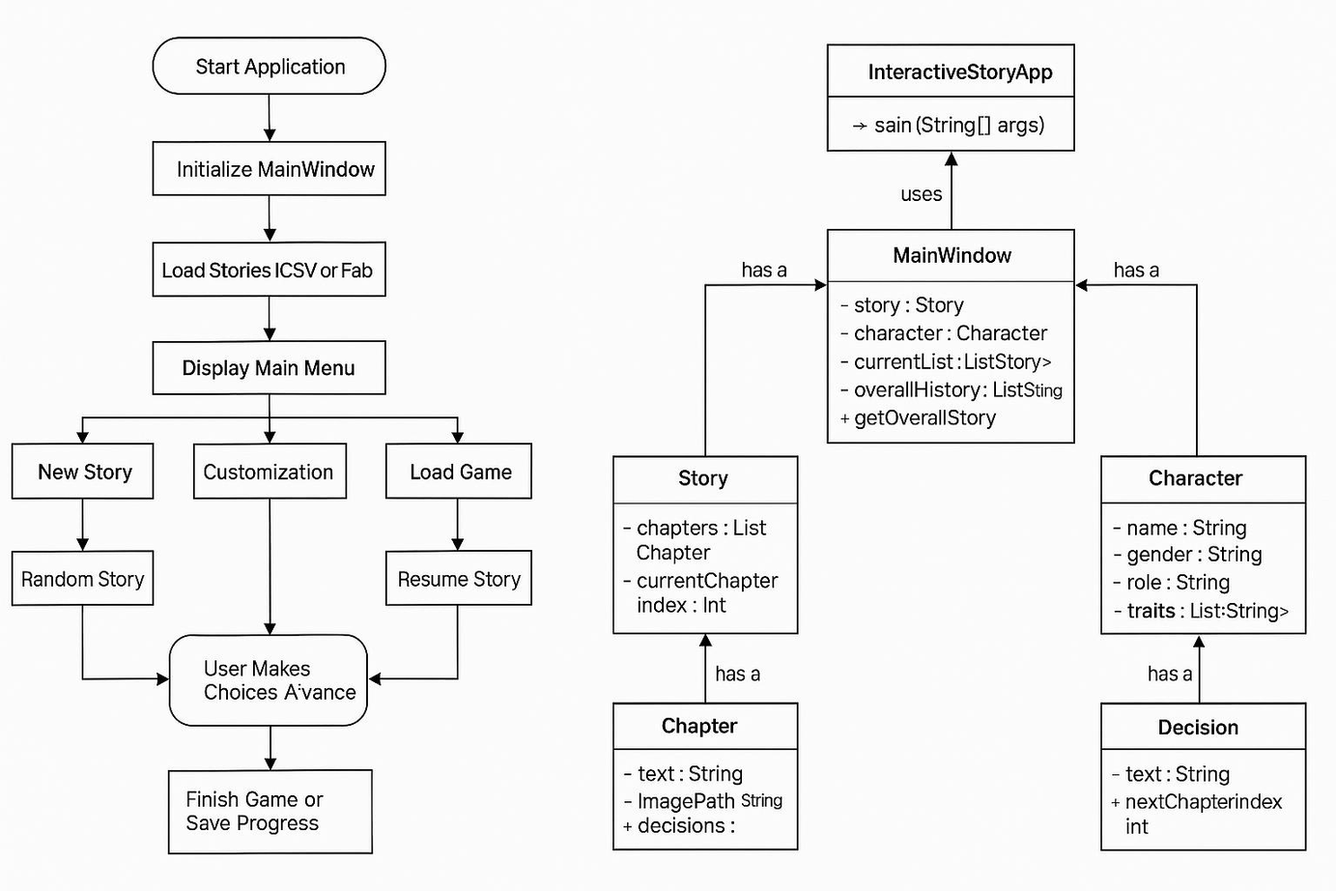

FLOW AND CLASS DIAGRAM

Slide 7

DESIGN PATTERNS
MVC (Model-View-Controller)
Model: Story, Chapter, Decision, Character.
View: MainMenuPanel, StoryPanel, CustomizationPanel, etc.
Controller: MainWindow, StoryLoader.
Factory Pattern
Class: UIFactory
Purpose: Creates styled buttons, labels, and UI components dynamically.
Singleton Pattern
Class: Theme
Purpose: Maintains a single instance for theme control (Light/Dark mode) across the app.
Observer Pattern
Example: StoryPanel updates automatically when story changes.
Purpose: UI panels observe state changes (e.g., game history, current chapter).
Strategy Pattern
Concept: Character roles affect story rendering logic dynamically.
Future Scope: Enable different narrative strategies for Adventurer, Wizard, Warrior roles.

Slide 8

Thank You
FOR YOUR TIME
Fauget Inc.

